Slide 1
Classification: Tree, Pruning, Bagging & Random Forest
Data Set:
Carseats (available in ISLR Package)

Slide 2
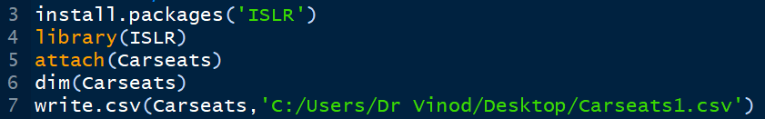

Install Package→ ISLR Attach → Carseats
Good idea to see structure also!

Slide 3
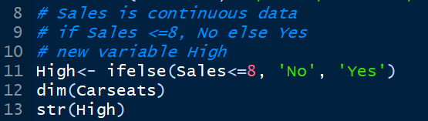
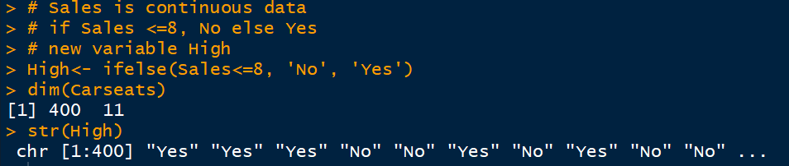
Use ifelse function for making Continuous variable, High, into Categorical variable

Slide 4
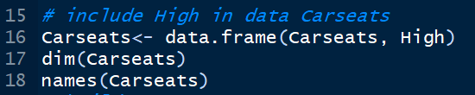
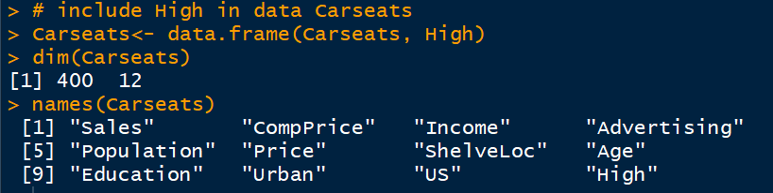
Add High into data set
No of variables increased to 12

Slide 5
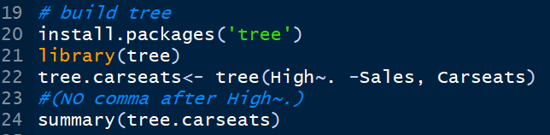
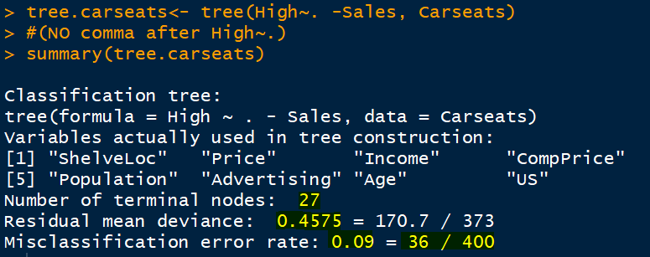
Install Package → tree
No point in having Sales as predictors
After ~. Don’t put comma)
Residual Mean Deviance is like RMSE, smaller the better!
36 are total misclassifed cases out of 400

Slide 6
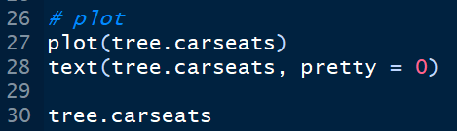
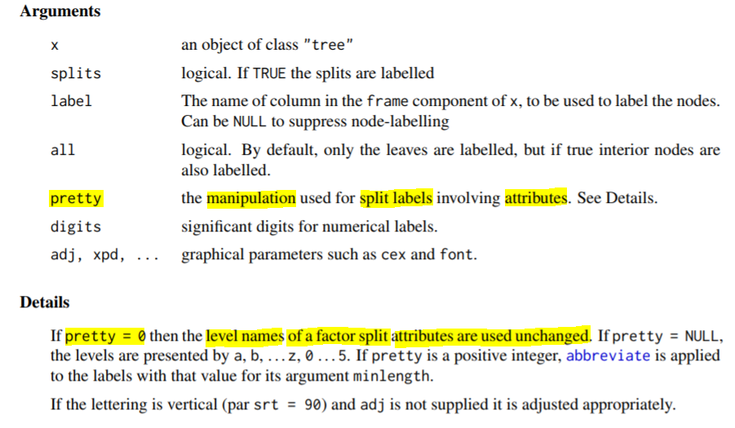
Plot the tree

Slide 7
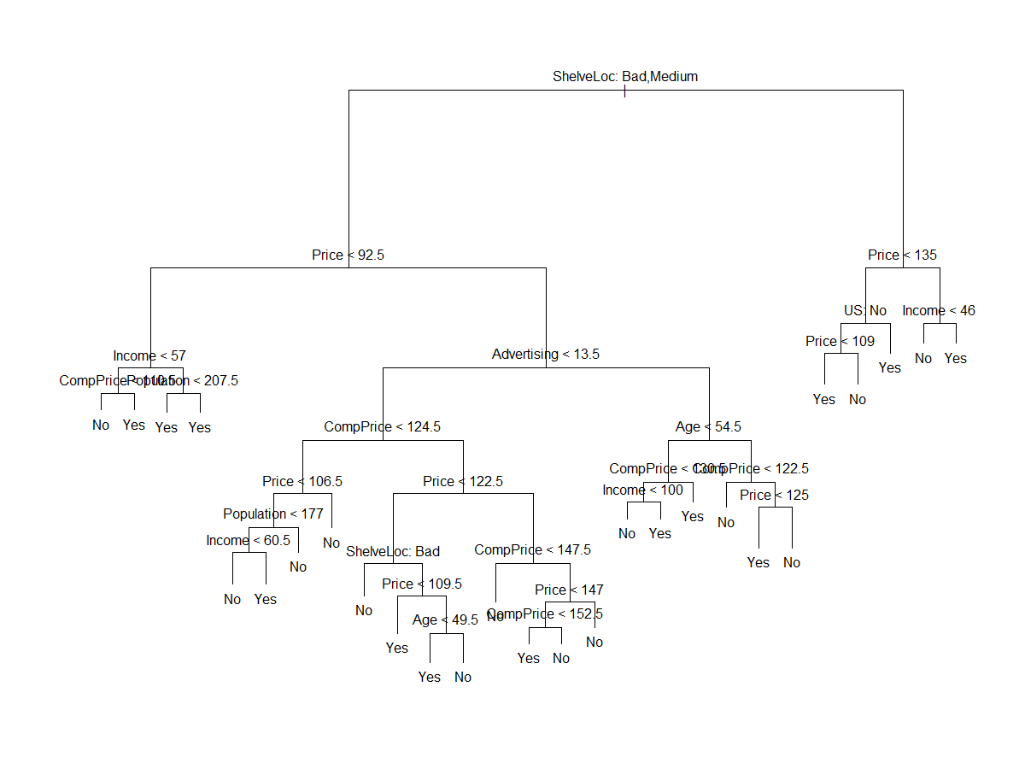
Counts terminal nodes
Classification accuracy of 81% is quite good!
But based on seen data!!

Slide 8
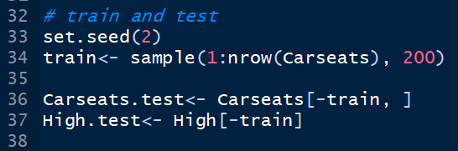
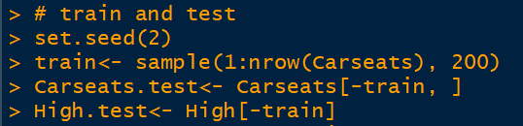
Lets have train and test data sets

Slide 9
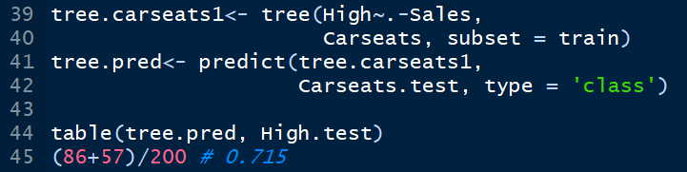
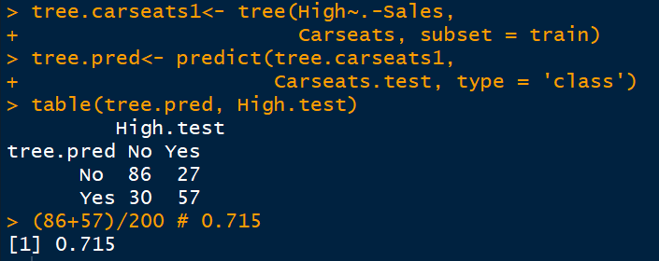
See the classification accuracy!
Dropped down from 81% to 71.5%

Slide 10

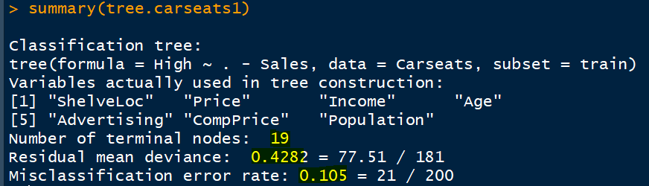
Summary of trained model
This 89.5% is of training set, must be tested on unseen data (testing data set)
The real test of model is on unseen data! 71.5%

Slide 11
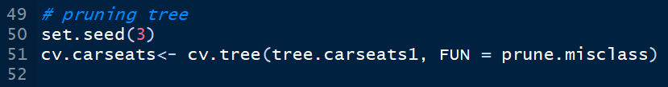
Lets prune the tree
cv stands for CROSS VALIDATION
It will create trees with 1 to 19 terminal nodes (19 is chosen by tree!)
FUN = prune.misclass means that classification error rate be the guiding rule for pruning

Slide 12


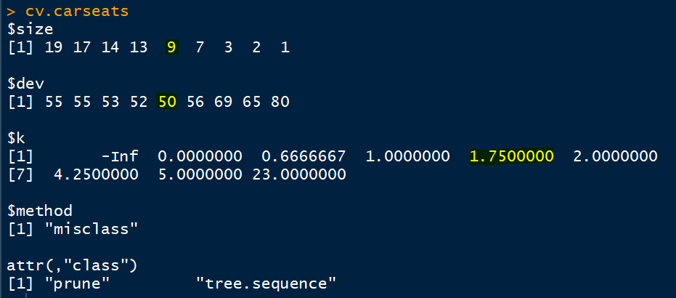
When to prune the tree?
50 is the minimum deviance correspond to 9 terminal nodes!
K is cost complexity factor

Slide 13
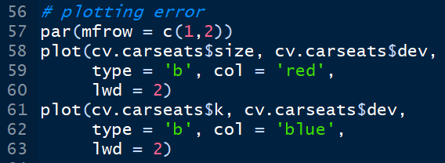
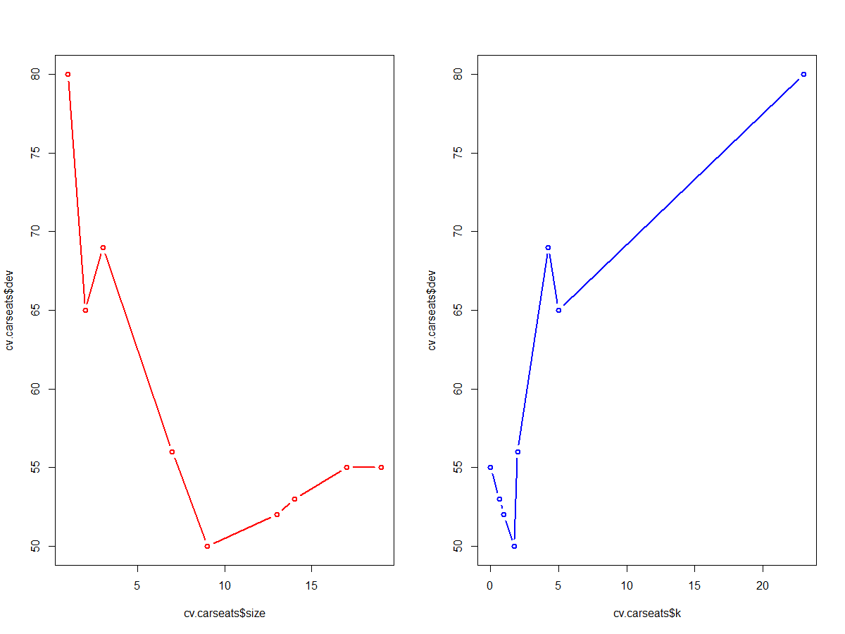
Size (number of terminal nodes) and cost complexity factor
As y-axis is deviance, look at the lowest values!
9
1.75

Slide 14
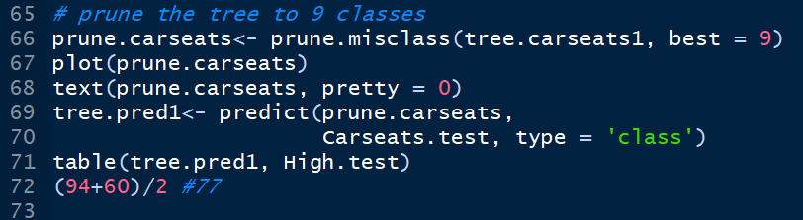
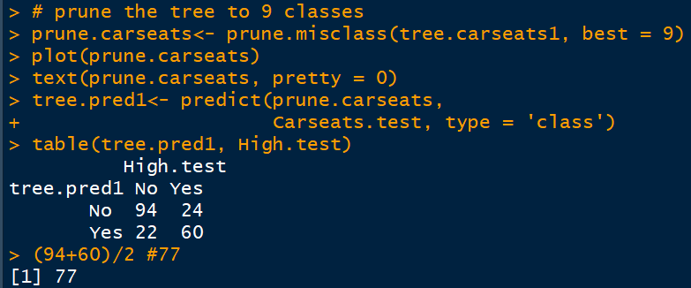
Again build tree with 9 terminal nodes
Good idea to first pass command
dev.off()
This will cancel par(mfrow = c(1,2)
Improved from 71.5% (unpruned) to 77% (pruned)

Slide 15
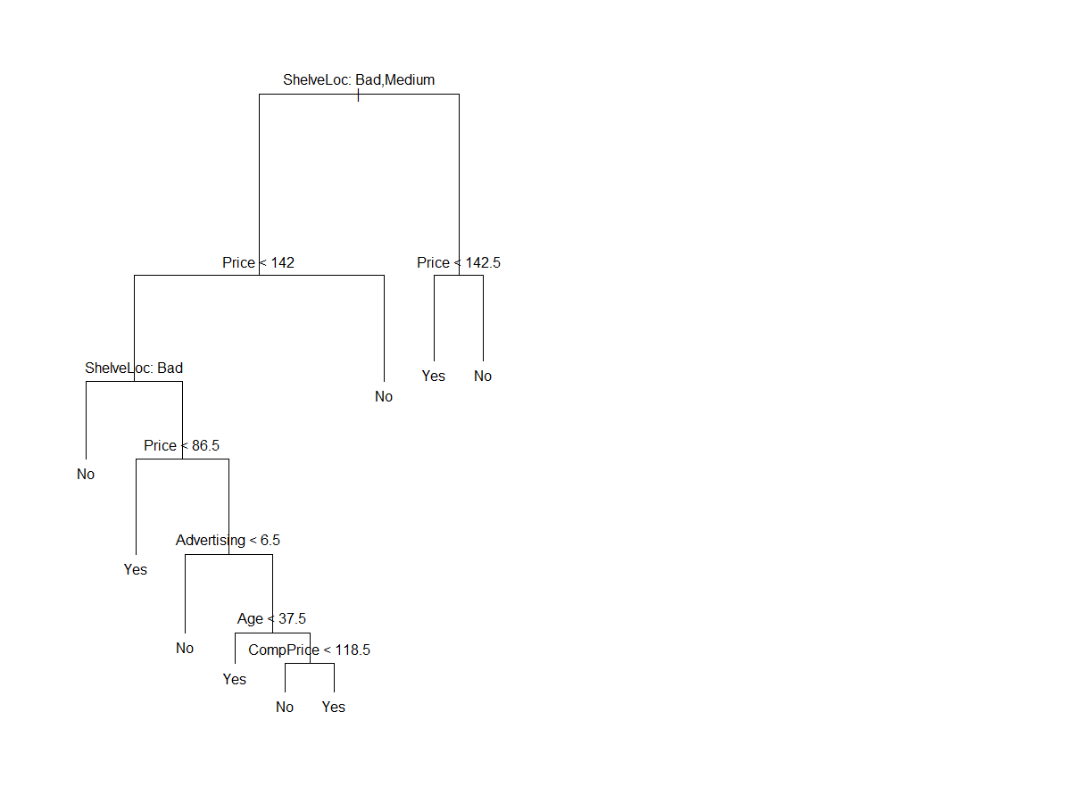
Count terminal nodes

Slide 16
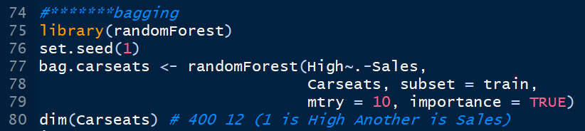
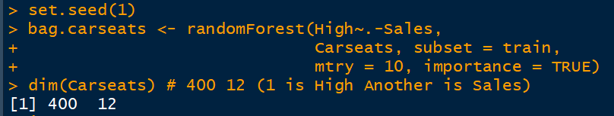
Bagging is random forest if all predictors are used for building trees
There were 12 variables, one is High and another is Sales

Slide 17
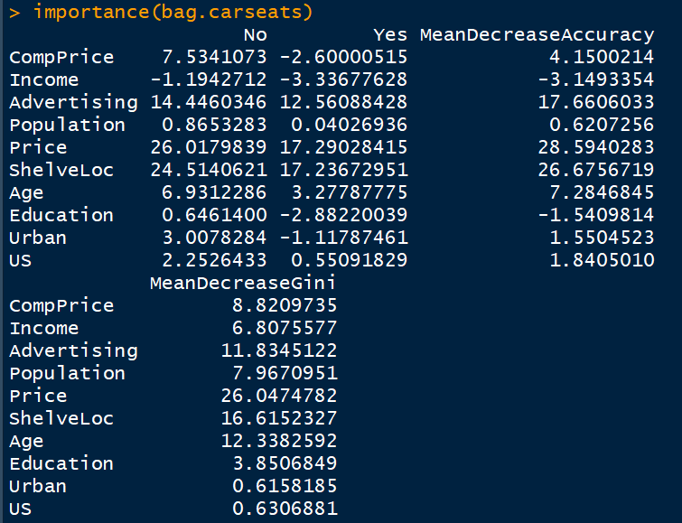

Which variables are important?
Price, ShelveLoc & Age are top three

Slide 18

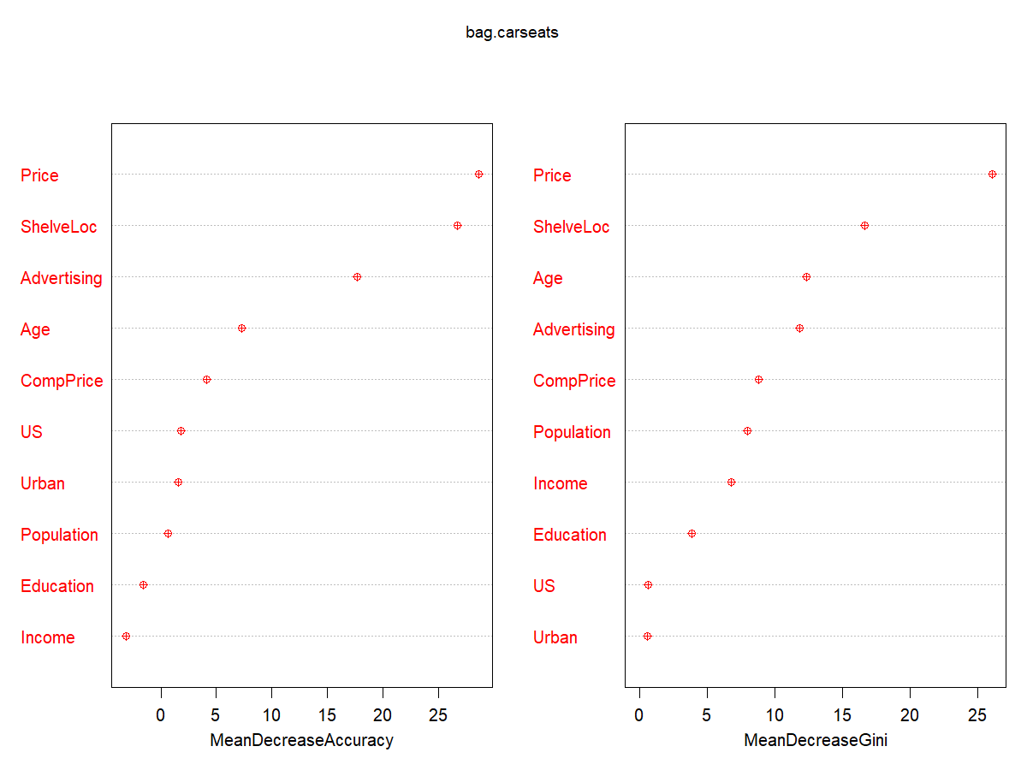
Price, ShelveLoc & Age are top three

Slide 19

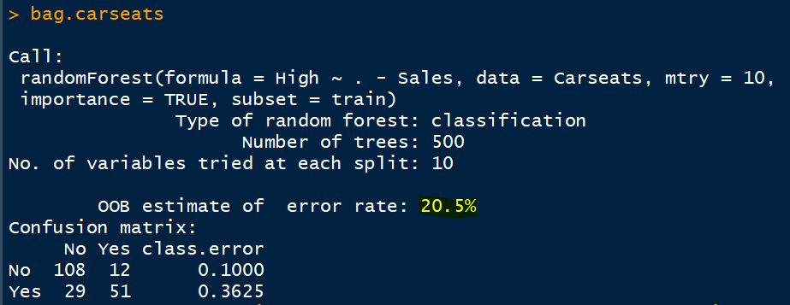
Trained Model (bagging)
79.8% Correct Classification Accuracy

Slide 20
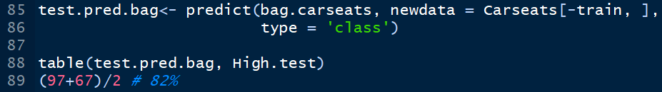
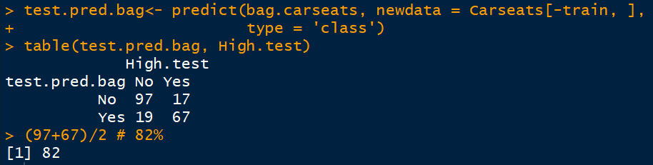
Test Results
Wow! 82%
Pruned = 77%
Unpruned = 71.5%

Slide 21
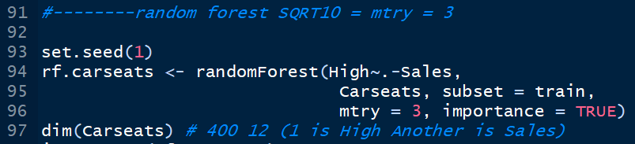
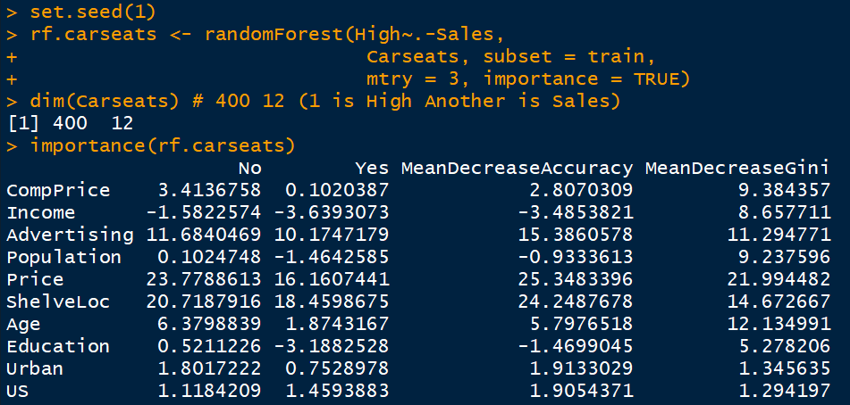
Random Forest
Price, ShelveLoc & Age are top three

Slide 22

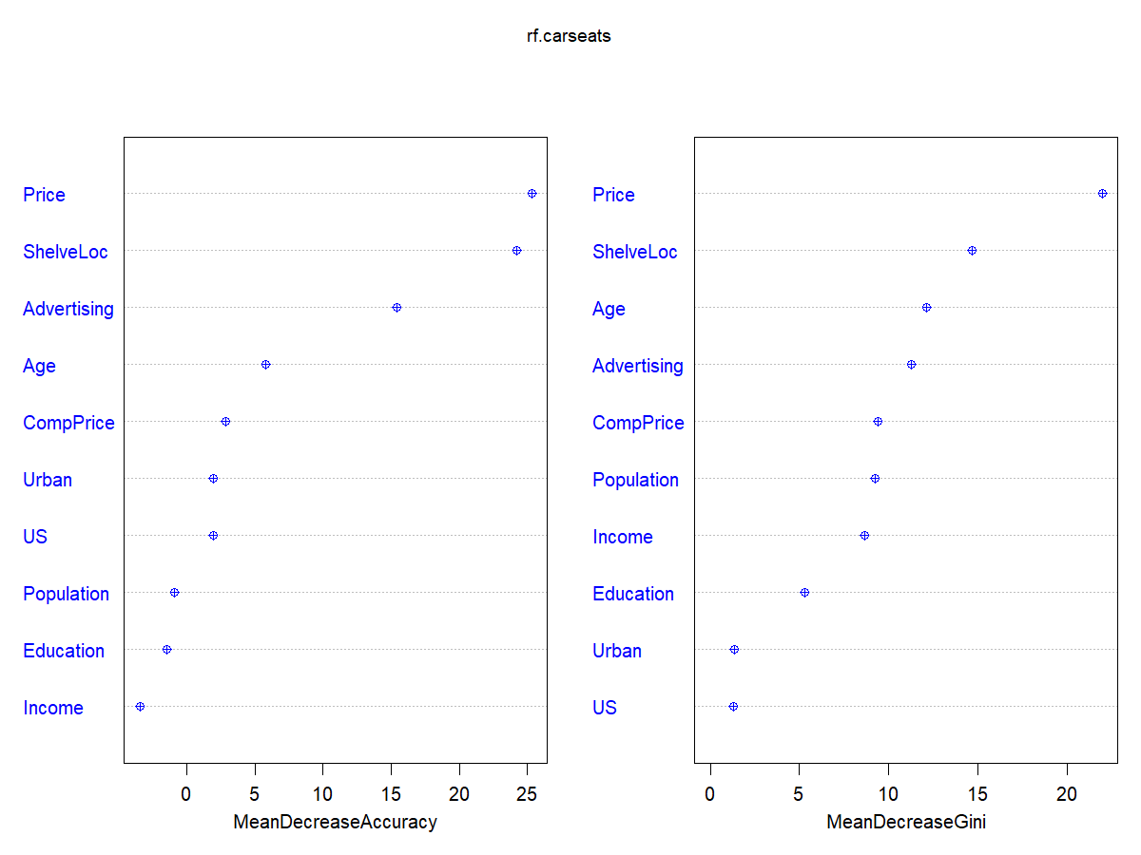
Price, ShelveLoc & Age are top three

Slide 23

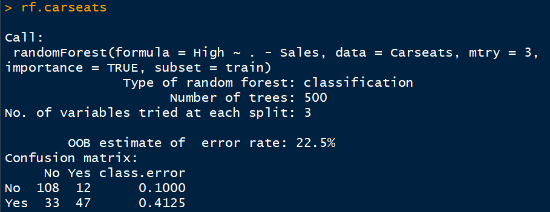
RF Trained Model

Slide 24
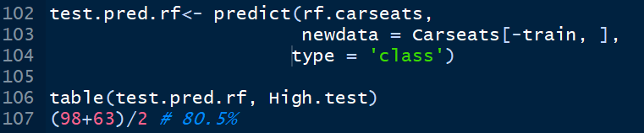
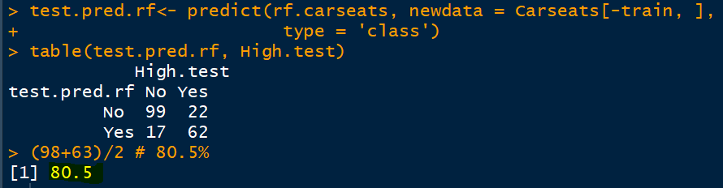
RF Tested Results
RF = 80.5%
Bagged = 82%
Pruned = 77%
Unpruned = 71.5%

Slide 25

Happy Learning

